Slide 1
0,0 of world coordinates
Absolute position is relative to the grid origin
No algorithm works with world coordinate system.
Algorithms use 2 coordinate systems:
Pedestrian’s local coordinate system:
Pedestrian’s position is the origin, intended direction of travel is the y-axis,
So, the origin of this CS is not static
Crosswalk coordinate system:
Center of the crosswalk is the origin of the system
Or just choose a random point
- Ped travel direction
Y-axis of ped’s local coordinate system
X-axis of the world coordinate system
Y-axis of the crosswalk CS
Z = x ** 3 – 4y + xy * 2
->
Z =
X axis of ped’s local coordinate system
Y-axis of the world coordinate system
X-axis of crosswalk CS

Slide 2
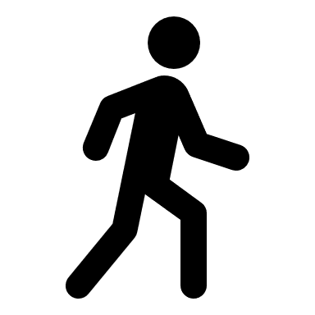


Task: Cross in a occluded situation
At t0, v_p 1,0
At t1, v_p 1, 2
At t2, v_p 1, 4
At t3, v_p 1, 6
At t4, v_p 1, 8
At t5, v_p 1, 10
At t0, v_p 1,0
At t1, v_p 1, 4
At t2, v_p 1, 8
At t3, v_p 1, 10
At t0, v_p 1,0
At t1, v_p 1, 2
At t2, v_p 1, 3
At t3, v_p 1, 6
At t5, v_p 1, 10
PositionAction

Slide 3
0 | 0 |  |  |  | 0 | 0 | 0
 |  |  |  |  |  |  | 0
Occupancy Grid: relative to position of some actor and how much they can see
0 | 0 |  |  |  | 0 | 0 | 0
 |  | 1 | 1
 |  | 1 | 1
 |  | 1 | 1
 |  |  |  | 0 | 0
 |  |  |  | 0 | 0
 |  |  |  | 0 | 0

